Slide 1
Green Pace | Security Policy Presentation
CS 405 Project Two
Developer: Michael Conrad
October 17, 2026
GREEN PACE • CS 405 PROJECT TWO 1 / 18
Notes:
Welcome to the Green Pace secure development policy presentation. This briefing builds on the Project One policy and explains how the development team can apply its ten standards consistently. I will discuss threat prioritization, layered controls, automated checks, and a focused unit-testing example. Replace the name field before submitting.

Slide 2
Overview | Defense in Depth
• Purpose: standardize secure C++ development across Green Pace
• Scope: staff who create, deploy, or support custom software
• Layers: input validation → secure code → access control → encryption → monitoring
• Verify controls with code review, static analysis, unit tests, and release gates
GREEN PACE • CS 405 PROJECT TWO 2 / 18
Notes:
Green Pace needs a repeatable policy as its development team grows. The Project One document establishes a common approach for secure C and C++ coding and operational security. Defense in depth means that no single safeguard is assumed to be perfect. For example, input validation prevents many malformed values from entering a program; safe memory and arithmetic practices reduce the damage from missed inputs; authentication and authorization limit exposure; and logging provides visibility into suspicious events. These layers should be implemented in the development lifecycle, not only after deployment.

Slide 3
Threat Matrix | Project One Ratings
• LIKELY + HIGH PRIORITY: STD-002, 003, 004, 005, 008, 009
• POSSIBLE + HIGH PRIORITY: STD-007
• UNLIKELY + HIGH PRIORITY: STD-001
• POSSIBLE + MEDIUM PRIORITY: STD-006, 010
• Highest documented level (5): STD-004, 005, 008, 009
GREEN PACE • CS 405 PROJECT TWO 3 / 18
Notes:
This matrix retains the qualitative likelihood and priority judgments in Project One rather than presenting them as measured probabilities. Six standards are rated likely and high priority: value validation, string boundaries, parameterized SQL, memory protection, integer overflow, and file path validation. Exception handling is possible and high priority, while safe data types are unlikely but still high priority because the potential severity is high. Assertions and resource release are possible and medium priority. Four standards have the highest documented level of five. Static analysis and tests can detect symptoms, but risk rankings require periodic review as architecture and exposure change.

Slide 4
Ten Security Principles | Standards Mapping
• 1 Validate input data → 001, 002, 003, 004, 008, 009
• 2 Heed compiler warnings → 001, 005, 008
• 3 Architect for security → 002, 004, 005, 009
• 4 Keep it simple → 003, 005, 010
• 5 Default deny → 004, 009
• 6 Least privilege → 004, 009
• 7 Sanitize data sent to systems → 004, 007, 009
• 8 Defense in depth → 002, 003, 004, 005, 007
• 9 Effective QA → all ten standards
• 10 Adopt secure coding standard → all ten standards
GREEN PACE • CS 405 PROJECT TWO 4 / 18
Notes:
The policy lists ten core principles: validate input, heed compiler warnings, architect for security, keep designs simple, default deny, apply least privilege, sanitize data crossing boundaries, use defense in depth, practice effective quality assurance, and adopt a secure coding standard. The numbers shown on the slide map each principle to relevant coding standards. These mappings are implementation recommendations based on the original policy examples, not a claim that each principle applies exclusively to the listed standards. Effective quality assurance and adherence to a coding standard apply to all ten.

Slide 5
Coding Standards | Risk-First Order
• 1. STD-004-CPP — Use Parameterized SQL Queries
• 2. STD-005-CPP — Manage Memory with RAII
• 3. STD-008-CPP — Prevent Integer Overflow
• 4. STD-009-CPP — Validate File Paths Before File Access
• 5. STD-002-CPP — Validate Values Before Use
• 6. STD-003-CPP — Prevent Out-of-Bounds String Access
• 7. STD-007-CPP — Handle Exceptions Without Exposing Sensitive Information
• 8. STD-001-CPP — Use Appropriate and Safe Data Types
• 9. STD-006-CPP — Do Not Use Assertions for Runtime Input Validation
• 10. STD-010-CPP — Release Resources Automatically
GREEN PACE • CS 405 PROJECT TWO 5 / 18
Notes:
This proposed remediation order starts with the four standards rated level five in Project One: parameterized SQL, RAII memory management, integer overflow protection, and safe file paths. Next are input-value validation and string bounds, both likely, high-priority risks rated level four, followed by exception handling. Safe data types, assertions, and automatic resource release complete the sequence. The ordering uses the policy level as the primary factor, then likelihood and potential exploit impact, with remediation cost used for scheduling. It is a proposed implementation order, not a replacement for a system-specific threat model.

Slide 6
Encryption | In Transit, At Rest, In Use
• In transit: TLS 1.2+ (prefer TLS 1.3); validate certificates
• At rest: AES-256 or approved managed storage encryption
• In use: minimize plaintext lifetime; restrict process and memory access
• Secrets and keys: vault/KMS, rotation, separate duties, no hard-coded keys
• Test certificate errors, permissions, key access, and failure behavior
GREEN PACE • CS 405 PROJECT TWO 6 / 18
Notes:
The encryption strategy addresses three states of data. In transit, approved TLS protects communications, with certificate verification and modern cipher configuration. At rest, approved encryption protects databases, backups, and files; key management is separate from application source code. Data in use generally must be decrypted for processing, so we minimize the duration and location of plaintext, restrict process privileges, and clear sensitive buffers where appropriate. Specialized confidential-computing approaches can provide further protections when justified. Encryption is not a substitute for input validation or authorization, and implementation should use maintained cryptographic libraries rather than custom algorithms.

Slide 7
Triple-A | Authentication, Authorization, Accounting
• Authentication: unique identities, MFA for privileged access, secure sessions
• Authorization: deny by default; role-based, least-privilege checks
• Accounting: timestamped, protected audit events and access reviews
• Never log passwords, tokens, keys, or sensitive personal data
• Alert on failed sign-ins, privilege changes, and unusual access
GREEN PACE • CS 405 PROJECT TWO 7 / 18
Notes:
Triple A stands for authentication, authorization, and accounting. Authentication verifies identity; authorization decides which operations that identity may perform; accounting records relevant activity for audit and investigation. Green Pace should require stronger authentication for administrators, verify authorization server-side for every sensitive action, and default to denying ambiguous requests. Logs should record who performed an action, when it occurred, and the outcome, while avoiding sensitive credentials. Audit access itself must be restricted and logs should be retained according to documented policy.

Slide 8
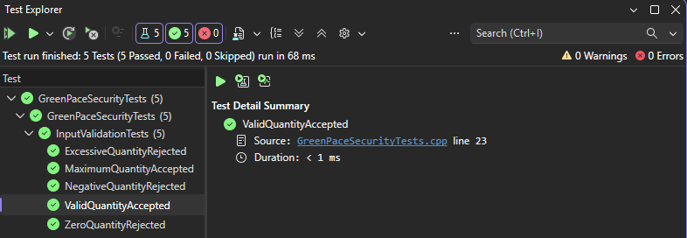
Unit Test 1 | ValidQuantityAccepted
STANDARD: STD-002-CPP
Validate Values Before Use
Test: Valid input
Input: 50
Expected validation result: true
Actual result: PASSED
Framework: Microsoft C++ Unit Test Framework
Evidence: Visual Studio Test Explorer
All 5 tests passed; 0 failed, 0 skipped.
GREEN PACE • CS 405 PROJECT TWO 8 / 18
Notes:
This test uses the Visual Studio Microsoft C++ Unit Test Framework to verify the STD-002-CPP input validation policy. The test ValidQuantityAccepted calls IsValidQuantity(50) and expects true. The uploaded Visual Studio screenshot documents a passed result. All five tests passed in the same run, with no failed or skipped tests. This is evidence for the example validation function, not a production application security assessment.

Slide 9
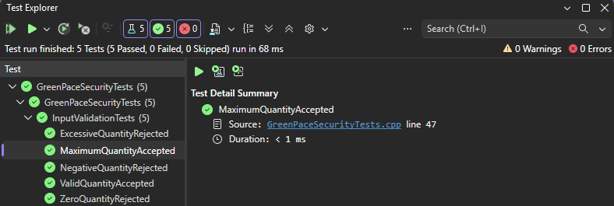
Unit Test 2 | MaximumQuantityAccepted
STANDARD: STD-002-CPP
Validate Values Before Use
Test: Upper boundary
Input: 100
Expected validation result: true
Actual result: PASSED
Framework: Microsoft C++ Unit Test Framework
Evidence: Visual Studio Test Explorer
All 5 tests passed; 0 failed, 0 skipped.
GREEN PACE • CS 405 PROJECT TWO 9 / 18
Notes:
This test uses the Visual Studio Microsoft C++ Unit Test Framework to verify the STD-002-CPP input validation policy. The test MaximumQuantityAccepted calls IsValidQuantity(100) and expects true. The uploaded Visual Studio screenshot documents a passed result. All five tests passed in the same run, with no failed or skipped tests. This is evidence for the example validation function, not a production application security assessment.

Slide 10
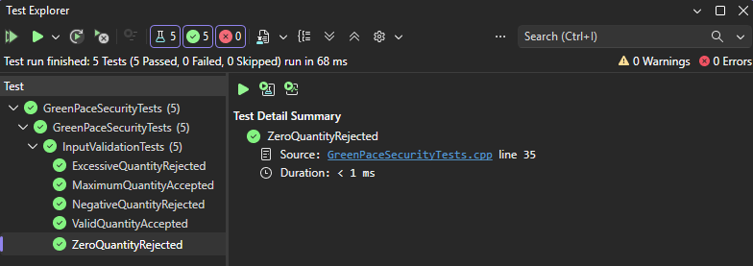
Unit Test 3 | ZeroQuantityRejected
STANDARD: STD-002-CPP
Validate Values Before Use
Test: Zero rejected
Input: 0
Expected validation result: false
Actual result: PASSED
Framework: Microsoft C++ Unit Test Framework
Evidence: Visual Studio Test Explorer
All 5 tests passed; 0 failed, 0 skipped.
GREEN PACE • CS 405 PROJECT TWO 10 / 18
Notes:
This test uses the Visual Studio Microsoft C++ Unit Test Framework to verify the STD-002-CPP input validation policy. The test ZeroQuantityRejected calls IsValidQuantity(0) and expects false. The uploaded Visual Studio screenshot documents a passed result. All five tests passed in the same run, with no failed or skipped tests. This is evidence for the example validation function, not a production application security assessment.

Slide 11
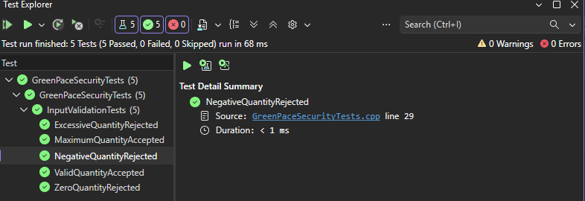
Unit Test 4 | NegativeQuantityRejected
STANDARD: STD-002-CPP
Validate Values Before Use
Test: Negative input rejected
Input: -5
Expected validation result: false
Actual result: PASSED
Framework: Microsoft C++ Unit Test Framework
Evidence: Visual Studio Test Explorer
All 5 tests passed; 0 failed, 0 skipped.
GREEN PACE • CS 405 PROJECT TWO 11 / 18
Notes:
This test uses the Visual Studio Microsoft C++ Unit Test Framework to verify the STD-002-CPP input validation policy. The test NegativeQuantityRejected calls IsValidQuantity(-5) and expects false. The uploaded Visual Studio screenshot documents a passed result. All five tests passed in the same run, with no failed or skipped tests. This is evidence for the example validation function, not a production application security assessment.

Slide 12
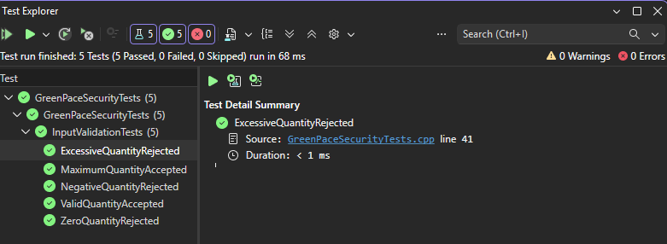
Unit Test 5 | ExcessiveQuantityRejected
STANDARD: STD-002-CPP
Validate Values Before Use
Test: Above limit rejected
Input: 101
Expected validation result: false
Actual result: PASSED
Framework: Microsoft C++ Unit Test Framework
Evidence: Visual Studio Test Explorer
All 5 tests passed; 0 failed, 0 skipped.
GREEN PACE • CS 405 PROJECT TWO 12 / 18
Notes:
This test uses the Visual Studio Microsoft C++ Unit Test Framework to verify the STD-002-CPP input validation policy. The test ExcessiveQuantityRejected calls IsValidQuantity(101) and expects false. The uploaded Visual Studio screenshot documents a passed result. All five tests passed in the same run, with no failed or skipped tests. This is evidence for the example validation function, not a production application security assessment.

Slide 13
Automation Summary | DevSecOps Lifecycle
• PLAN: threat model and security requirements
• CODE: peer review, pre-commit linting and secrets scanning
• BUILD: compiler warnings /WX; clang-tidy; Cppcheck; dependency scans
• TEST: C++ unit tests, sanitizers, fuzzing, integration tests
• DEPLOY + MONITOR: approved releases, audit logs, alerts, patch feedback
GREEN PACE • CS 405 PROJECT TWO 13 / 18
Notes:
The DevSecOps pipeline integrates security into the entire software lifecycle. During planning, teams document assets and trust boundaries. During coding, review and linting identify unsafe patterns. At build time, the C++ compiler runs and warnings should be treated as errors where practical. Clang-tidy and Cppcheck supplement the compiler; dependency and secrets scanners flag additional risks. During testing, the Visual Studio unit test framework checks expected behavior and sanitizer or fuzz testing can reveal memory problems. Release gates block builds that fail mandatory checks. Production monitoring then informs future fixes and policy updates.

Slide 14
External Tools | Where They Fit
• MSVC /W4 /WX: compile and flag unsafe conversions
• Clang-Tidy: static checks for C++ defects and risky constructs
• Cppcheck: supplemental static analysis for C/C++
• Visual Studio Test Explorer: execute regression/unit tests
• AddressSanitizer + fuzzing: dynamic memory and edge-case testing
• SAST/DAST findings: triage, assign, fix, retest, track exceptions
GREEN PACE • CS 405 PROJECT TWO 14 / 18
Notes:
These tools provide different types of evidence. The compiler runs during every build and can catch unsafe conversions and other suspicious constructs. Clang-tidy and Cppcheck inspect source code without requiring a production run, although they do not prove a program is safe. Visual Studio Test Explorer executes the unit tests and provides pass or fail results. AddressSanitizer instruments supported builds to reveal memory violations, while fuzzing exercises unusual inputs. Dynamic application testing can assess deployed interfaces. Each tool should be placed at a defined pipeline stage, with documented owners and follow-up actions. A green scan is not proof that no vulnerability exists.

Slide 15
Risks and Benefits | Act Now or Wait
• SQL injection and unsafe paths: fix now; prevent data exposure
• Integer overflow and memory errors: fix now; prevent crashes/exploitation
• Input/string validation: fix before release; reduce malformed-data risk
• Delay: longer exposure, larger remediation cost, potential incident
• Tradeoffs: engineering effort, false positives, regression risk
• Mitigation: staged rollout, code review, regression tests, rollback plan
GREEN PACE • CS 405 PROJECT TWO 15 / 18
Notes:
Acting now on high-risk weaknesses can reduce the chance of data loss, system compromise, and operational disruption. SQL injection and unauthorized file access may expose sensitive information. Integer overflow and unsafe memory handling can produce crashes or exploitable behavior. Waiting allows these conditions to persist and can increase remediation complexity as more code depends on vulnerable behavior. Immediate changes also carry costs: engineering time, compatibility concerns, and false positives. Green Pace should use small reviewed changes, test coverage, staged deployment, and rollback plans to reduce those implementation risks.

Slide 16
Recommendations | Close Current Gaps
• Enforce mandatory CI checks for all 10 standards
• Add explicit security owners and remediation deadlines
• Expand tests: boundaries, malformed input, fuzzing, sanitizers
• Review privilege, logging, keys, and dependency inventory
• Track exceptions with justification, expiry, and approval
• Measure: open critical findings, time-to-fix, test coverage
GREEN PACE • CS 405 PROJECT TWO 16 / 18
Notes:
The current policy establishes important standards, but the next step is to operationalize them. Each standard should have a documented automated or manual verification method and a responsible owner. Green Pace should require consistent checks in continuous integration and specify when a failed check blocks release. Expand testing beyond the quantity example to string lengths, integer overflow, file traversal, and SQL query construction. Maintain a current dependency inventory and review authentication, key management, and logging configurations. Policy exceptions should be time-limited, approved, and reassessed. Metrics such as unresolved high-severity findings and remediation time will reveal whether the program is improving.

Slide 17
Conclusion | Sustainable Secure Development
• Adopt SEI CERT C++ guidance and OWASP ASVS where applicable
• Align the program with NIST SSDF (SP 800-218)
• Threat-model changes before implementation
• Require evidence-based release gates and periodic policy review
• Build a feedback loop: detect → fix → retest → improve
GREEN PACE • CS 405 PROJECT TWO 17 / 18
Notes:
In conclusion, Green Pace can turn its written policy into a sustainable security program by combining clear standards with continuous verification. The SEI CERT C++ guidance supports language-specific practices, while the NIST Secure Software Development Framework provides a lifecycle structure. OWASP application verification requirements can help assess application-facing controls. The highest-risk findings should be remediated first, and new functionality should receive threat modeling and automated testing before release. Security policy should be reviewed regularly as threats, dependencies, and systems change. The goal is repeatable evidence that safeguards are working, not simply a checklist.

Slide 18
References | APA Style
Carnegie Mellon University, Software Engineering Institute. (n.d.). SEI CERT C++ coding standard. https://wiki.sei.cmu.edu/confluence/display/cplusplus
National Institute of Standards and Technology. (2022). Secure software development framework (SSDF) version 1.1 (SP 800-218). https://doi.org/10.6028/NIST.SP.800-218
OWASP Foundation. (n.d.). Application security verification standard. https://owasp.org/www-project-application-security-verification-standard/
Microsoft. (n.d.). Unit test your code (C++). https://learn.microsoft.com/en-us/visualstudio/test/writing-unit-tests-for-c-cpp
Green Pace. (2026). Green Pace secure development policy [Unpublished course project].
GREEN PACE • CS 405 PROJECT TWO 18 / 18
Notes:
The presentation draws on the completed Green Pace Project One policy and supporting guidance from the SEI CERT C++ coding standard, NIST SSDF, OWASP ASVS, and Microsoft documentation on C++ unit testing. These resources provide further detail on secure coding, lifecycle practices, application verification, and the Visual Studio testing workflow.

